Slide 1
Data Science Internship
Presented By :
Purva R . Mene
CO3040

Slide 2


Internship Program
Powered By

Slide 3
PROGRAM HIGHLIGHTS
Live And Recorded Classes
Career Support Services
Complition Certificate
Duration : 6 Weeks

Slide 4
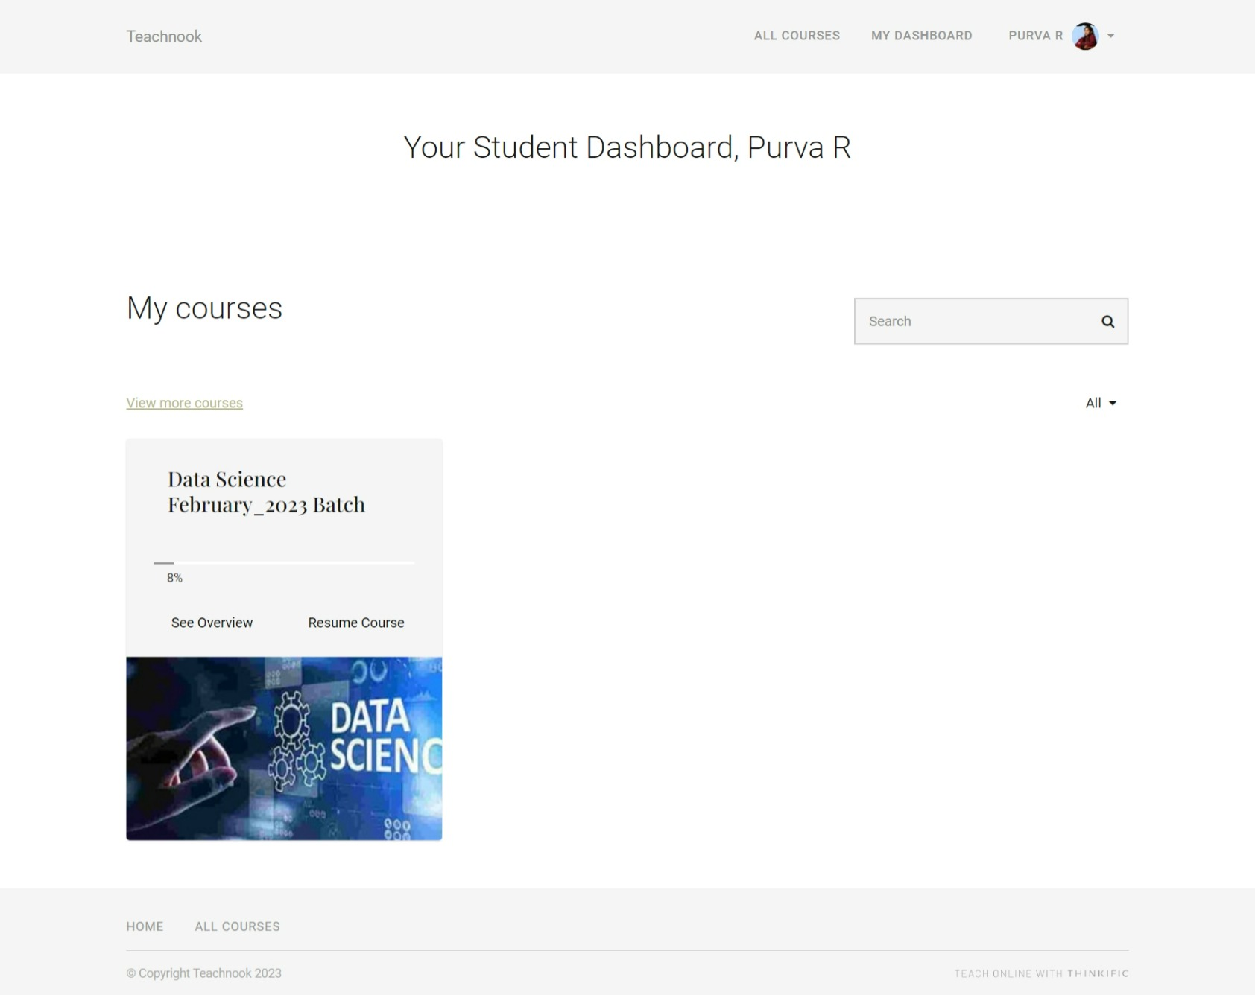
PLATFORM

Slide 5
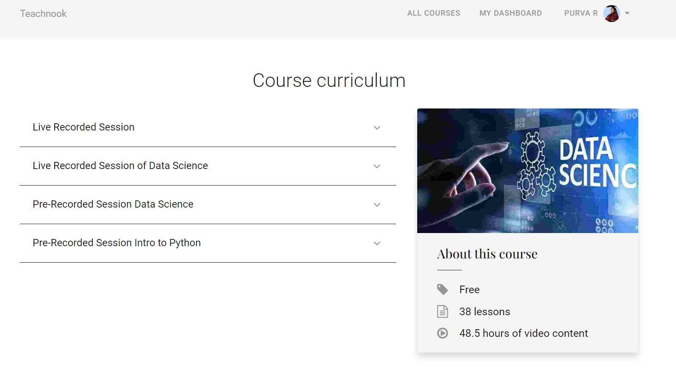
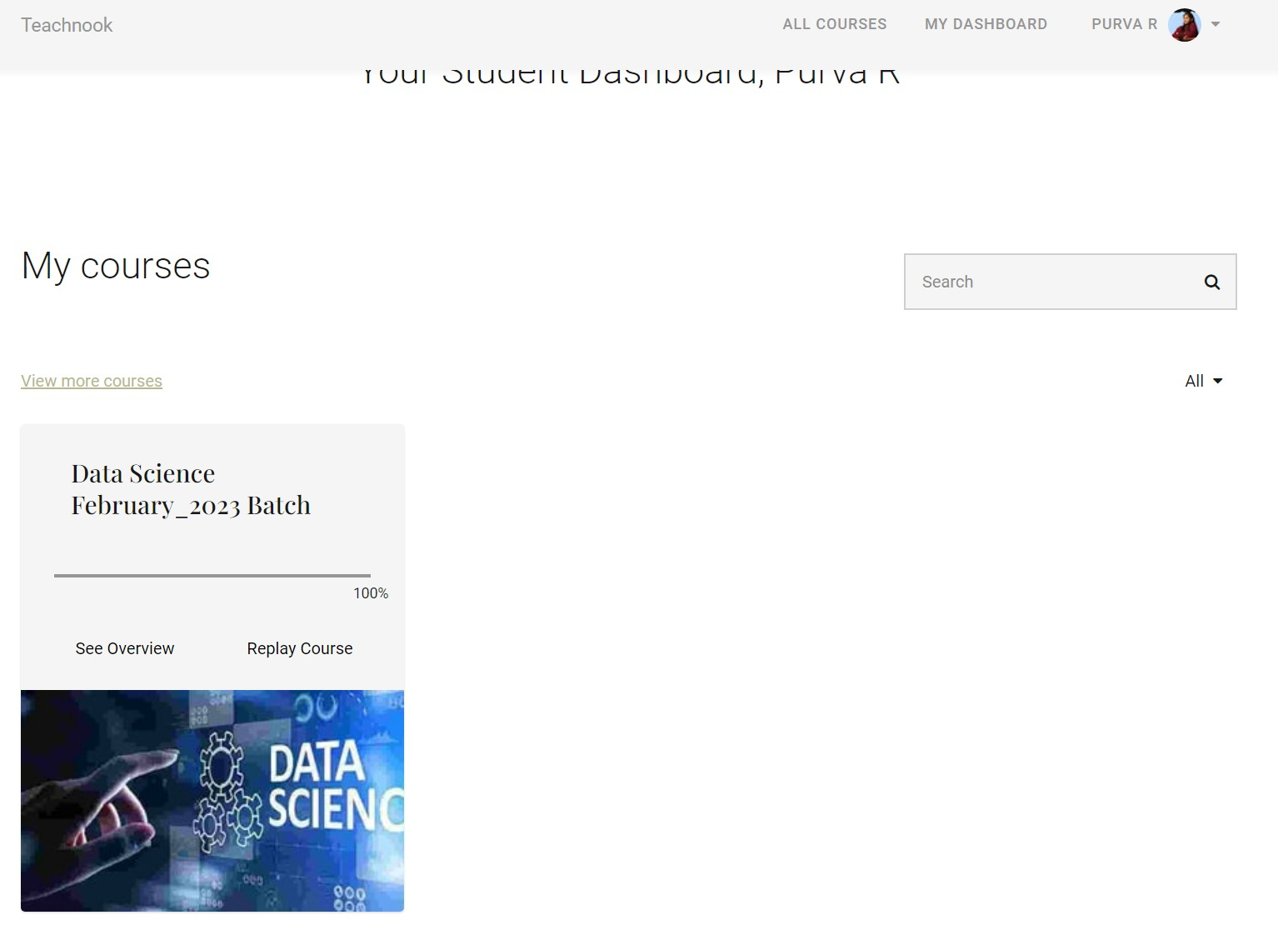
MODULES

Slide 6
Data science combines math and statistics, specialized programming, advanced analytics, artificial intelligence (AI), and machine learning with specific subject matter expertise to uncover actionable insights hidden in an organization’s data. The accelerating volume of data sources, and subsequently data, has made data science is one of the fastest growing field across every industry.
INTRODUCTION

Slide 7
Why Data Science is Important?
More and more companies are coming to realize the importance of data science, AI, and machine learning. Regardless of industry or size, organizations that wish to remain competitive in the age of big data need to efficiently develop and implement data science capabilities or risk being left behind.

Slide 8
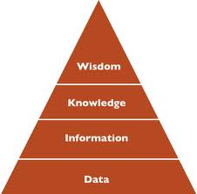
Data Mining/Data Analytics

Slide 9
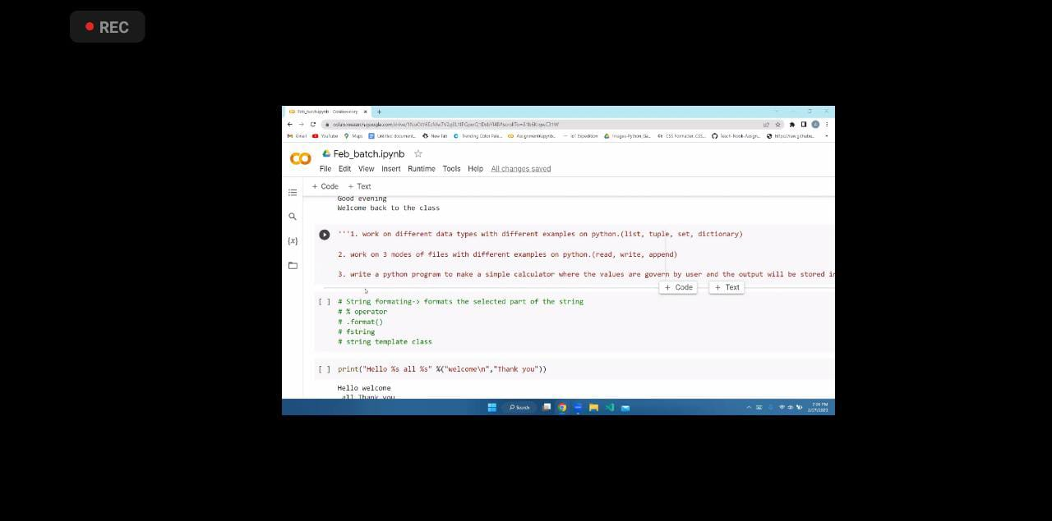
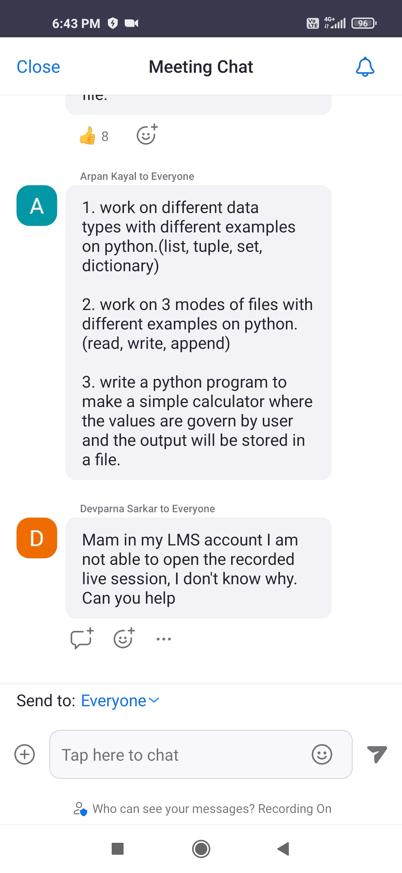
TRAINING AND DOUBT SOLVING SESSION

Slide 10
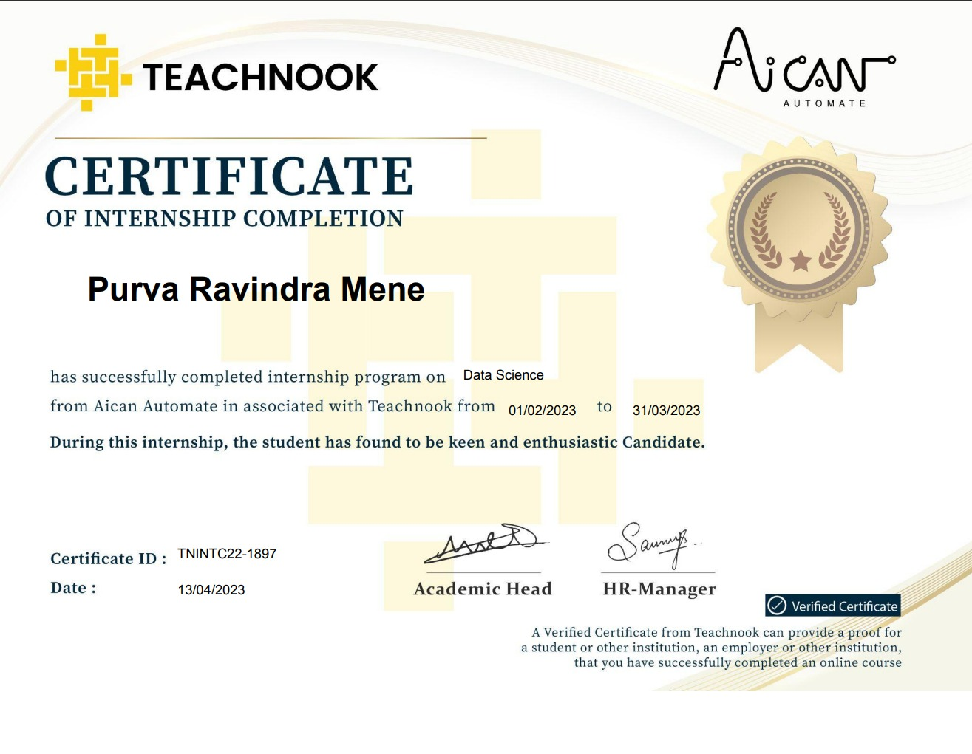
CERTIFICATE

Slide 11
CONCLUSION
This internship has given me a very useful experience. I have found out what my strengths and weaknesses are, I gained new knowledge and skills which was not only regarding the theoretical part but also on the coding part.
The best part of this internship is that this internship has not only given me the chance to learn but most valuable skill of all that is networking which I think is much important at this point of time.

Slide 12

https://docs.microsoft.com/en-us/learn/
https://youtube.com/channel/UCRQbNl0J1ky2hxPoB3TVEMA
https://futureskillsprime.in/
https://www.geeksforgeeks.org/webtechnology/#:~:text=Web%20Technology%20refers%20to%20the,and%20video%20on%20the%20Internet.

Slide 13
THANK YOU …!

